Slide 1
Electromagnetic Waves NUCLEAR Bombs
Skye Yang

Slide 2
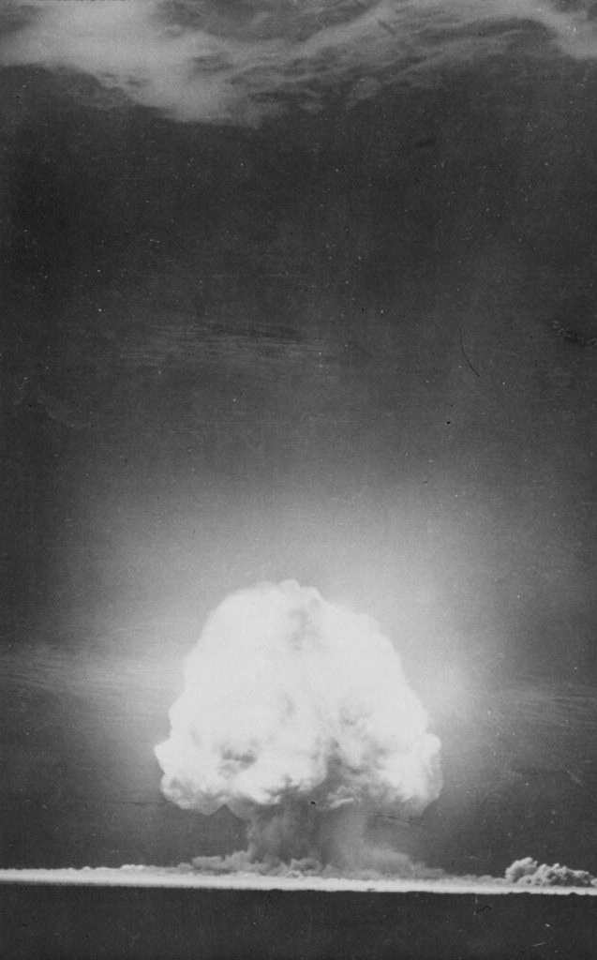
History
Development of an atomic bomb started in 1932
First success from the U.S. Manhattan Project
Led by Robert Oppenheimer
First successful detonation on Alamogordo, New Mexico 1945
Most famous use is on Hiroshima and Nagasaki, Japan 1945
Releases large amounts of energy from a nuclear reaction
Uses Uranium or Plutonium
They were use by planes dropping them down on large open places
After an explosion, it produces EM waves like radio and gamma rays

Slide 3
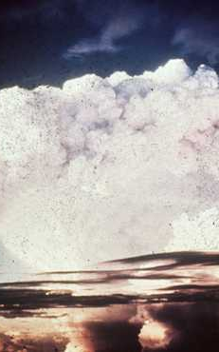
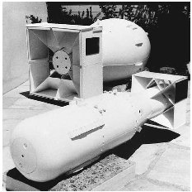
Evolved
In 1952, it’s successor Hydrogen Bomb was created
The U.S. first successfully denoted a H-Bomb near Bikini Atoll in the Marshall Islands
The only real use of H Bombs were to intimate your enemies
Instead of using a nuclear reaction, it uses a thermonuclear reaction
H Bombs are were more powerful than atomic
Instead of dropping bombs, people use them as missiles

Slide 4












Benefits
We got an amazing movie about Robert
Japan lost its empiristic cultural and became kawaii anime sushi work cultural
Funny Spongebob theory
It’s so good using it in Call Of Duty MW2 and Mobile
The United States became the most powerful nation in the world
World wars are less likely to happen
Soldiers lives aren’t at risk

Slide 5


Risks
It gives a very boring excuse of post apocalyptic worlds
Most nuking jokes are not funny
It made the Soviet Union become a powerful nation
Also North Korea
Can kill over 10,000 people
The radiation from a bomb can ruin the entire ecosystem
Can harm many generations
It’s a fear tactic
Nations can gain power and conquer with just having it
Any nation can just use them

Slide 6

Future
Look, this ain’t happening anytime soon
It’s probably never going to be use in a very bad way
Especially with the technology we have now
Making a more powerful nuclear bomb would be very irrelevant

Slide 7

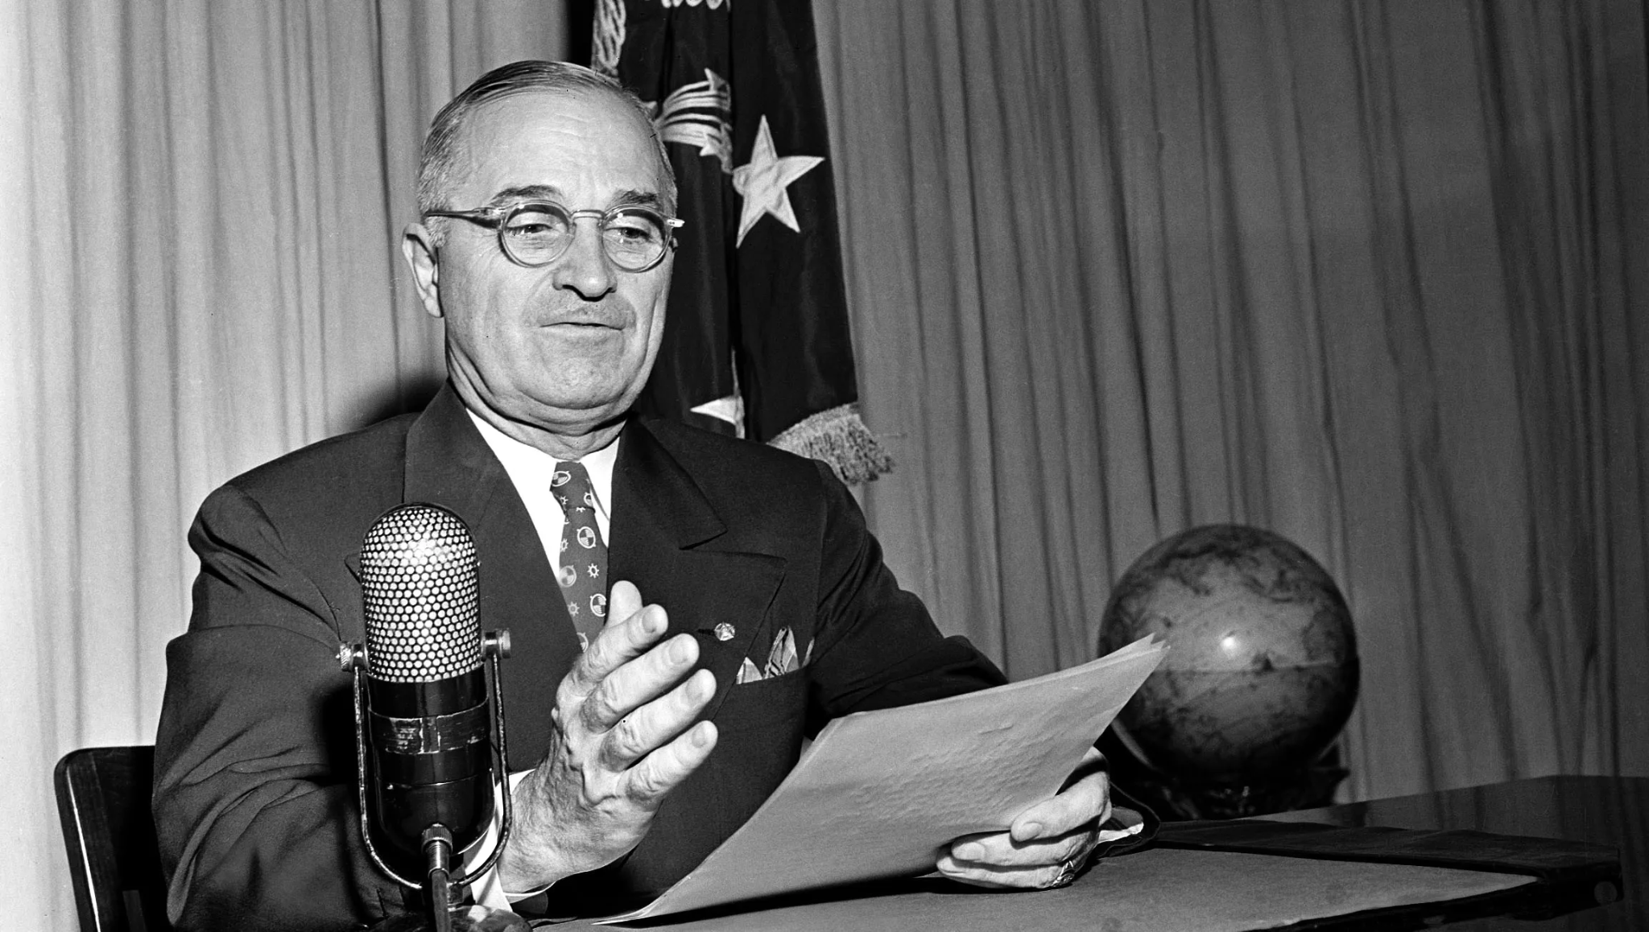
Sources
https://www.atomicarchive.com/science/effects/emp.html
https://go.galegroup.com/ps/retrieve.do
https://go.gale.com/ps/retrieve.do
https://go.gale.com/ps/i.do
https://go.gale.com/ps/retrieve.do
https://go.gale.com/ps/retrieve.do
https://go.gale.com/ps/retrieve.do
https://go.gale.com/ps/retrieve.do

